Slide 1
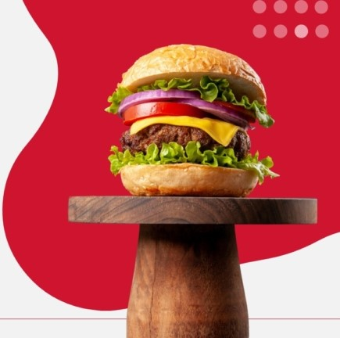

Zomato Analytics Project
1.Meghana NR

Slide 2

Introduction
What is Zomato?
Zomato is a global restaurant discovery and food delivery platform, founded in 2008. It has a wide presence in India and abroad.
Through this project, we analyze customer behavior, cuisine trends, service offerings, and geographical distribution of restaurants using tools like Excel, Power BI, Tableau, and SQL.
Mission: “Ensure nobody has a bad meal.”

Slide 3
9551 Total Restaurants
141 Total Cities
2.89 Average Rating
1826 Total Cuisines
15 Total Countries
1.5 M Total Votes

Slide 4

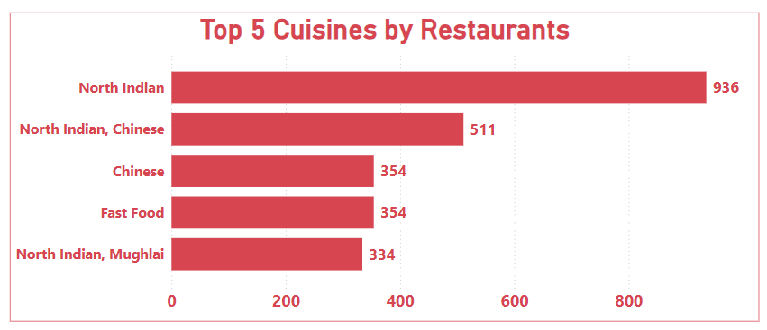
Cuisine Popularity
North Indian cuisine leads by a large margin with 936 restaurants, showing its widespread popularity.
North Indian appears in 3 of the top 5 categories, making it the most versatile and in-demand cuisine

Slide 5

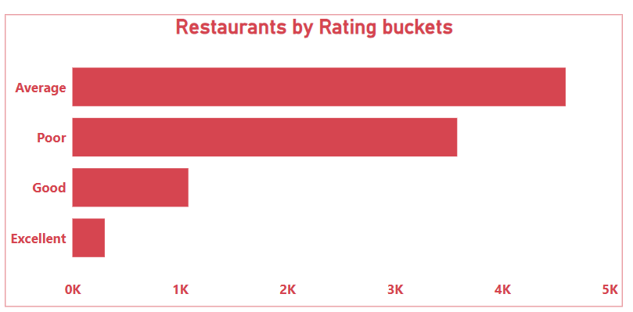
Restaurant Performance
A majority of restaurants are rated as Average, followed closely by Poor ratings.
High-rated (Excellent) restaurants are very few, indicating limited top-tier quality.
The data shows a clear need for quality enhancement across most restaurants.

Slide 6
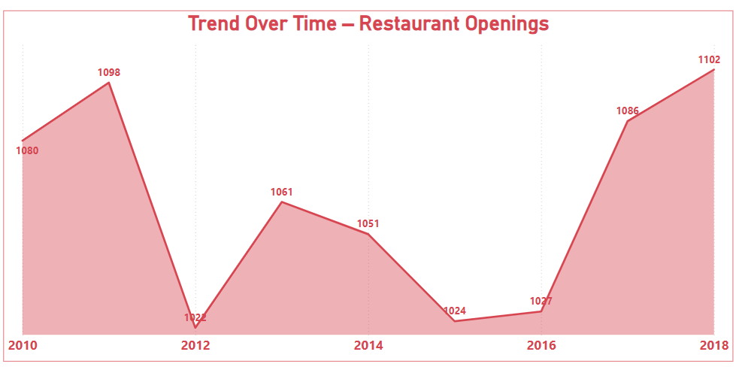
Trend Over Time – Restaurant Openings
Restaurant openings dropped after 2011 but picked up again after 2016.
The highest number of openings was in 2018 with 1102 restaurants.
Overall, there's a positive growth trend in recent years

Slide 7
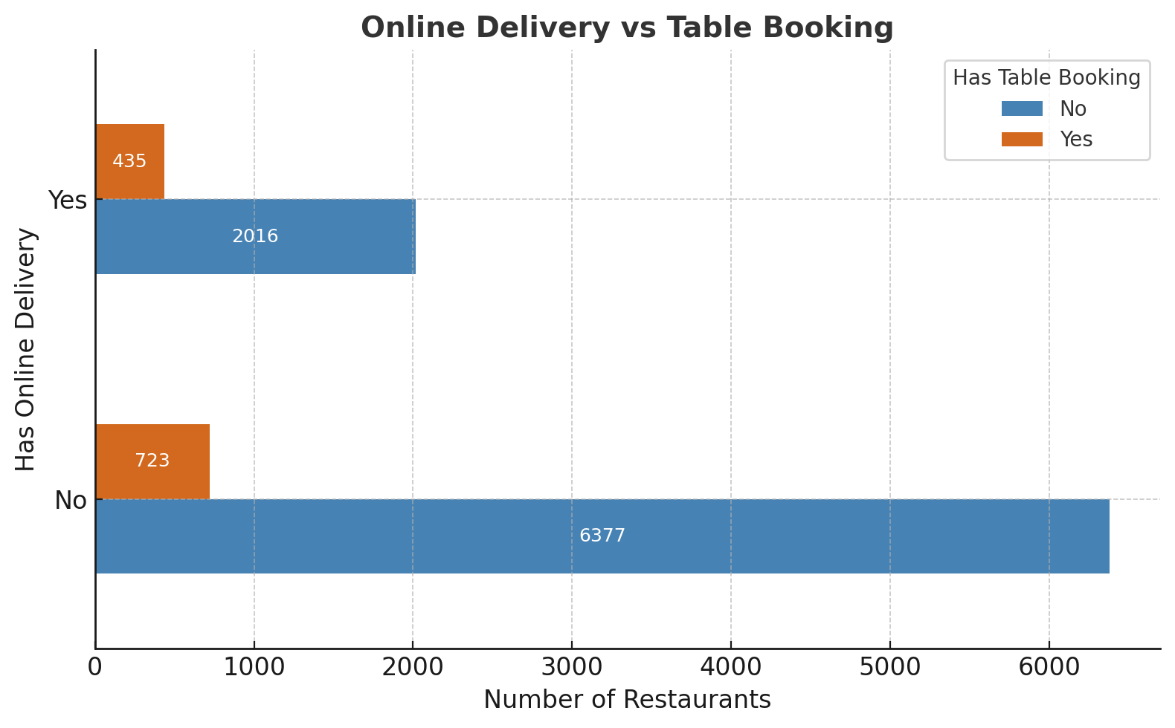
Online Delivery v/s Table Booking
Has_Online_Delivery | Has_Table_Booking | Restaurant_Count
No | No | 6377
No | Yes | 723
Yes | No | 2016
Yes | Yes | 435
🔹 Most Zomato-listed restaurants offer neither Online Delivery nor Table Booking. 🔸 Very few restaurants offer both services.

Slide 8
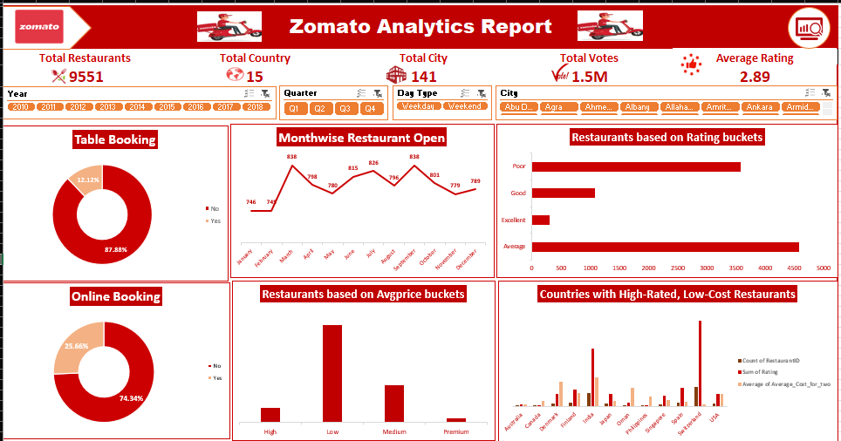
Excel Dashboard

Slide 9
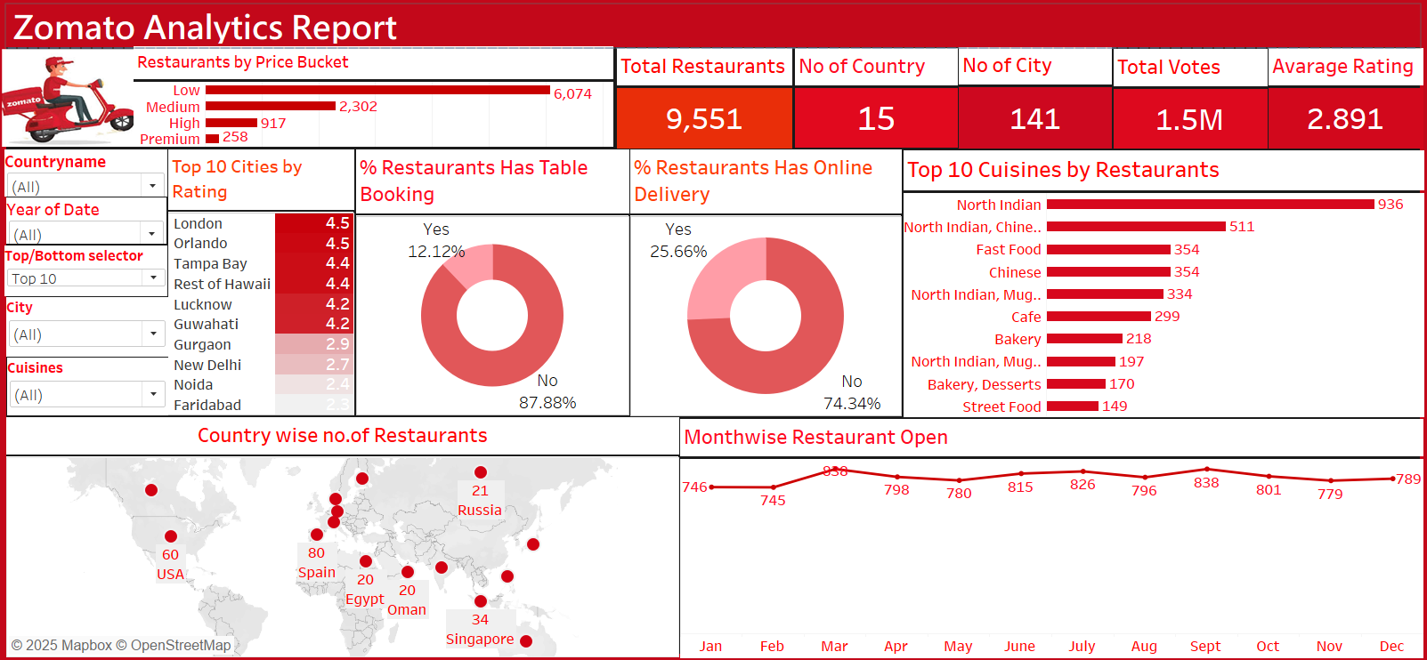
Tableau Dashboard

Slide 10
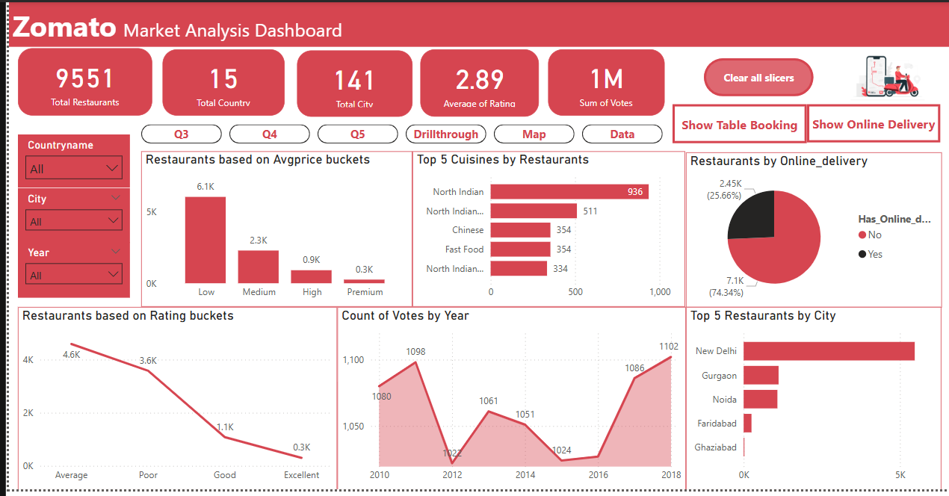
Power BI Dashboard

Slide 11
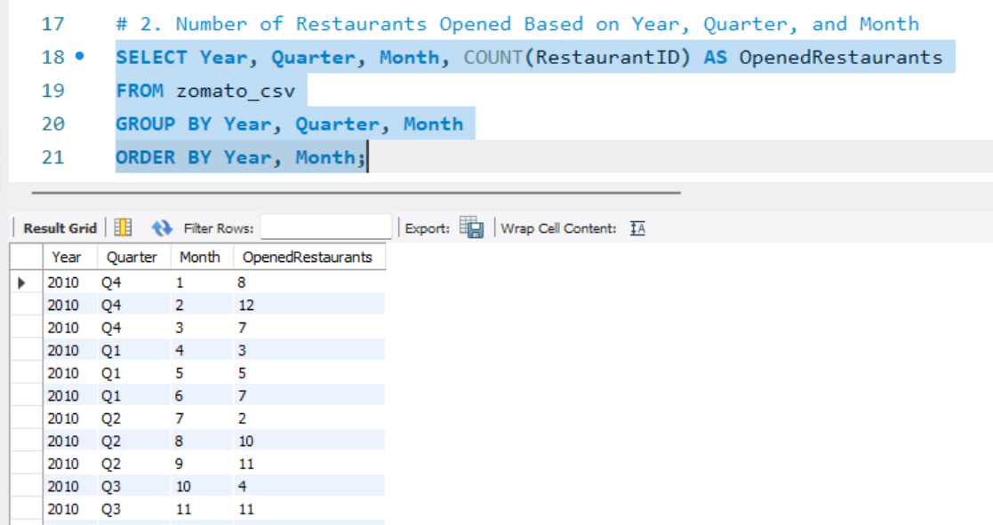
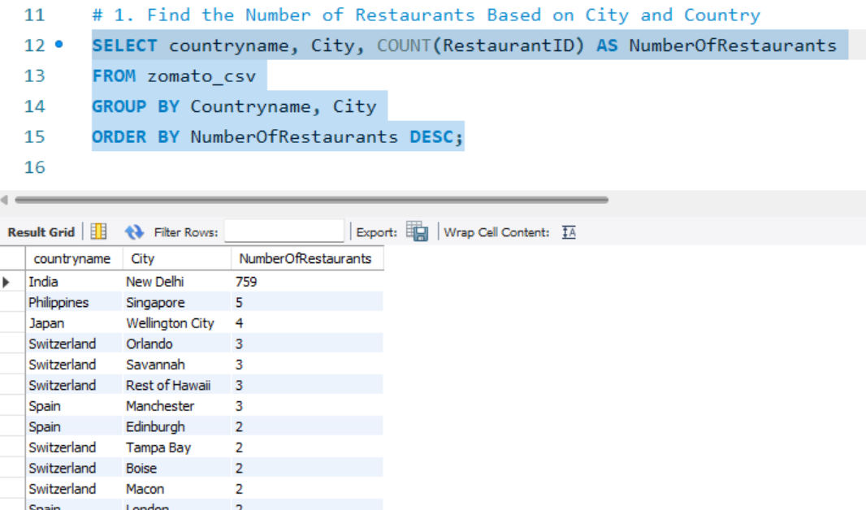
SQL Queries

Slide 12
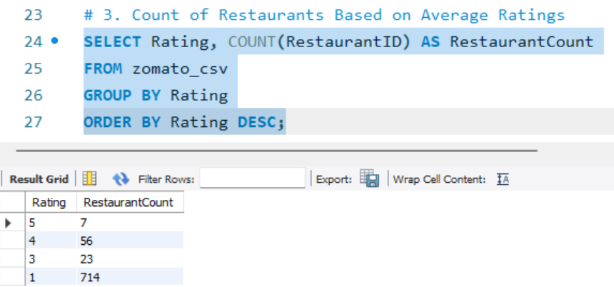
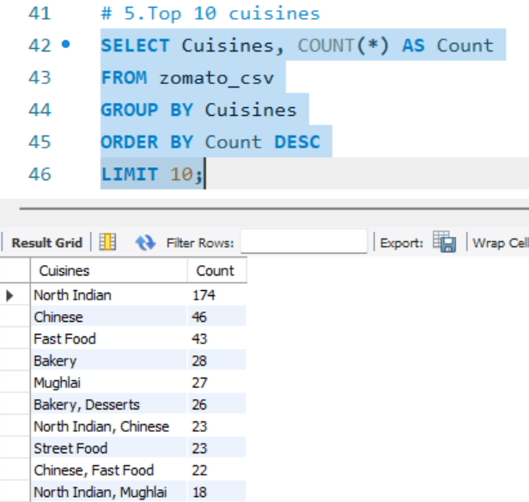

Slide 13

Summary of Key Insights
1. North Indian cuisine is the most dominant and versatile across restaurants.
2. A majority of restaurants fall under Average or Poor rating buckets, indicating a need for better quality and service.
3. Online delivery is more popular than dine-in, especially among frequent users.
4. Users are grouped as Budget Diners, Premium Users, Frequent Orderers, and Explorers, each with unique preferences.
5. Top-rated restaurants perform better in visibility and engagement, proving the value of customer satisfaction.
6. .Restaurant openings have increased since 2016, especially in metro cities, showing rising market demand.

Slide 14
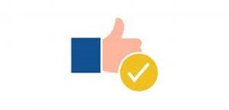
Final Recommendations
Encourage more online orders using discounts and ad campaigns.
📍Grow in smaller cities where there’s rising food demand.
🎁 Reward loyal users with points, offers, and engagement features.
🍛 Collaborate with popular local restaurants to attract regional customers.
🧠 Personalize the app experience with smart dish suggestions.
📦 Encourage more online orders using discounts and advertisement
💰 Create special offers during festivals and busy hours.
🌟 Reward top-rated restaurants with higher visibility to encourage quality improvement.

Slide 15
Thank You!
Zomato

